Slide 1
Describing Data

Slide 2
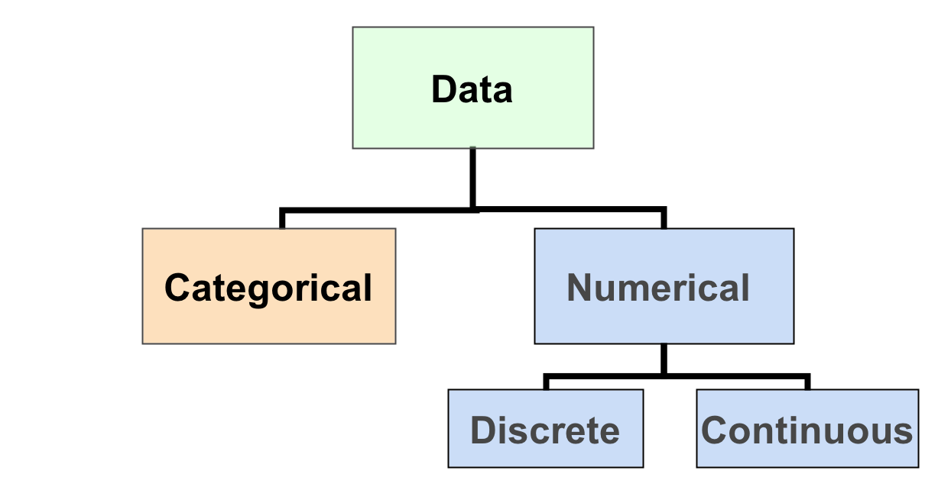
Types of Data
Ex:
- Marital Status
- Are you registered to vote?
- Eye Color
(Defined categories or groups)
Ex:
Number of Children
Defects per hour
(Counted items)
Ex:
Weight
Voltage
(Measured characteristics)

Slide 3
Measurement Levels
Differences between measurements, true zero exists
Ratio Data
Quantitative Data
Differences between measurements but no true zero
Interval Data
Ordered Categories (rankings, order, or scaling)
Ordinal Data
Qualitative Data
Categories (no ordering or direction)
Nominal Data
Notes:
Interval scales are numeric scales in which we know not only the order, but also the exact differences between the values. The classic example of an interval scale is Celsius temperature because the difference between each value is the same. For example, the difference between 60 and 50 degrees is a measurable 10 degrees, as is the difference between 80 and 70 degrees. Time is another good example of an interval scale in which the increments are known, consistent, and measurable.
Interval scales are nice because the realm of statistical analysis on these data sets opens up. For example, central tendency can be measured by mode, median, or mean; standard deviation can also be calculated.
Here’s the problem with interval scales: they don’t have a “true zero.” For example, there is no such thing as “no temperature.” Without a true zero, it is impossible to compute ratios. With interval data, we can add and subtract, but cannot multiply or divide. Confused? Ok, consider this: 10 degrees + 10 degrees = 20 degrees. No problem there. 20 degrees is not twice as hot as 10 degrees
Ratio scales are the ultimate nirvana when it comes to measurement scales because they tell us about the order, they tell us the exact value between units, AND they also have an absolute zero–which allows for a wide range of both descriptive and inferential statistics to be applied. At the risk of repeating myself, everything above about interval data applies to ratio scales + ratio scales have a clear definition of zero. Good examples of ratio variables include height and weight.
Ratio scales provide a wealth of possibilities when it comes to statistical analysis. These variables can be meaningfully added, subtracted, multiplied, divided (ratios). Central tendency can be measured by mode, median, or mean; measures of dispersion, such as standard deviation and coefficient of variation can also be calculated from ratio scales.

Slide 4
Quantitative vs Qualitative
Quantitative | Qualitative
Measured on numeric scale Height Weight Temperature Scores on an exam | No ordering or measuring Favorite color Religion City of Birth Favorite Sport
Notes:
Quantitative variables are distinguished from categorical variables such as favorite color, religion, city of birth, and favorite sport in which there is no ordering or measuring involved. Categorical variables are sometimes called “qualitative variables.”

Slide 5
Describing Data
Graphically

Slide 6
Graphical Presentation of Data
Data in raw form are usually not easy to use for decision making
Some type of organization is needed (table, graph)
The type of graph to use depends on the variable being summarized.
Goals for effective data presentation:
Present data to display essential information.
Communicate complex ideas clearly and accurately.
Avoid distortion that might convey the wrong message.

Slide 7
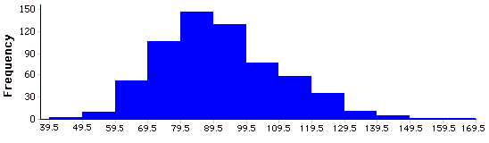
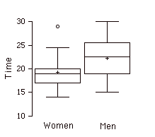
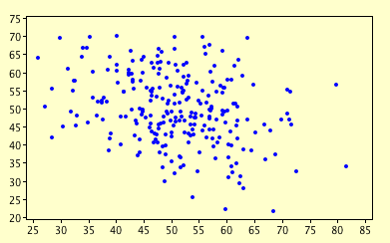
Notes:
Some types of graphs are good at summarizing differences between distributions. These two box plots compare the time to complete a task for men and women
whereas others, like this histogram, are best-suited for large amounts of data.
while others, like this scatter plot, are used to show the relationship between variables.

Slide 8
Graphical Presentation of Data
(continued)
Categorical
Variables
Numerical
Variables
Frequency distribution
Bar chart
Pie chart
Pareto diagram
Line chart
Frequency distribution
Histogram and ogive
Stem-and-leaf display
Scatter plot

Slide 9
Categorical Variables
Categorical Data
Tabulating Data
Graphing Data
Frequency Distribution Table
Bar Chart
Pie Chart
Pareto Diagram

Slide 10
Frequency Distribution Table
Example: Hospital Patients by Unit
Hospital Unit Number of Patients
Cardiac Care 1,052
Emergency 2,245
Intensive Care 340
Maternity 552
Surgery 4,630
Variables are categorical

Slide 11
Bar Chart Example
Example: Hospital Patients by Unit
Hospital Number
Unit of Patients
Cardiac Care 1,052
Emergency 2,245
Intensive Care 340
Maternity 552
Surgery 4,630
Notes:
Effective for showing the frequencies of different categories.
Bar charts can present quantitative information other than frequencies
Effective for showing change over time.
The drawback to this figure is that it gives the false impression that the games are naturally ordered in a numerical way.

Slide 12
Pie Chart Example
Example: Hospital Patients by Unit
Hospital Number % of
Unit of Patients Total
Cardiac Care 1,052 11.93
Emergency 2,245 25.46
Intensive Care 340 3.86
Maternity 552 6.26
Surgery 4,630 52.50

Slide 13
Pie Chart Example
import matplotlib.pyplot as plt
# Pie chart, where the slices will be ordered and plotted counter-clockwise:
labels = 'Frogs', 'Hogs', 'Dogs', 'Logs'
sizes = [15, 30, 45, 10]
explode = (0, 0.1, 0, 0) # only "explode" the 2nd slice
fig1, ax1 = plt.subplots()
ax1.pie(sizes, explode=explode, labels=labels, autopct='%1.1f%%',
shadow=True, startangle=90)
ax1.axis('equal') # Equal aspect ratio
plt.show()
https://matplotlib.org/gallery/pie_and_polar_charts/pie_features.html

Slide 14
Pie Charts
Not recommended when there are many categories
Not recommended for comparing two survey instruments.
“The only worse design than a pie
chart is several of them.”
-Edward Tufte
Notes:
Pie charts are effective for displaying the relative frequencies of a small number of categories. They are not recommended, however, when you have a large number of categories. Pie charts can also be confusing when they are used to compare the outcomes of two different surveys or experiments. In an influential book on the use of graphs, Edward Tufte asserted "The only worse design than a pie chart is several of them."

Slide 15
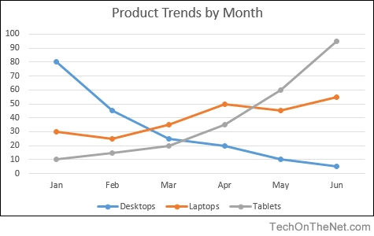
Line Graphs
A bar graph with the tops of the bar represented by points joined by lines.
Better than bar graphs at comparing changes over time
Correct only when both the X- and Y-axes are quantitative
Notes:
A line graph is a bar graph with the tops of the bars represented by points joined by lines. The rest of the bar is hidden.
Although bar graphs and line graphs are similar, line graphs emphasize the change from period to period more clearly than do bar charts.
Line graphs are appropriate only when both the X- and Y-axes display quantitative (rather than qualitative) variables. Although bar graphs can also be used in this situation, line graphs are generally better at comparing changes over time.

Slide 16
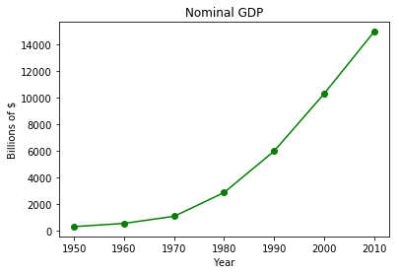
import matplotlib.pyplot as plt
years = list(range(1950, 2011, 10))
gdp = [300.2, 543.3, 1075.9, 2862.5, 5979.6, 10289.7, 14958.3]
# create a line chart, years on x-axis, gdp on y-axis
plt.plot(years, gdp, color='green', marker='o', linestyle='solid')
# add a title
plt.title("Nominal GDP")
# add a label to the y-axis
plt.ylabel("Billions of $")
# add a label to the x-axis
plt.xlabel("Year")
plt.show()

Slide 17
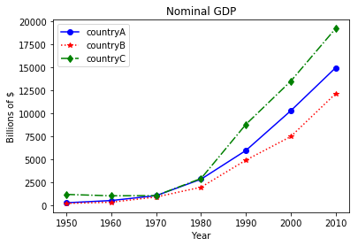
import matplotlib.pyplot as plt
years = list(range(1950, 2011, 10))
gdp1 = [300.2, 543.3, 1075.9, 2862.5, 5979.6, 10289.7, 14958.3]
gdp2 = [226.0, 362.0, 928.0, 1992.0, 4931.0, 7488.0, 12147.0]
gdp3 = [1206.0, 1057.0, 1081.0, 2940.0, 8813.0, 13502.0, 19218.0]
# create a line chart, years on x-axis, gdp on y-axis
# use format string to specify color, marker, and line style
# e.g. ‘bo-’: color=‘blue’, marker=‘o’, linestyle=‘solid’
plt.plot(years, gdp1, ‘bo-', years, gdp2, ‘r*:', years, gdp3, ‘gd-.')
# add a title
plt.title("Nominal GDP")
# add a label to the y-axis
plt.ylabel("Billions of $")
# add a label to the x-axis
plt.xlabel("Year")
# add legend
plt.legend([‘countryA', ‘countryB', ‘countryC'])
plt.show()

Slide 18
Pareto Diagram
The 80/20 Rule
80% of web traffic comes from 20% of your site’s pages.
80% of customer complaints are caused by 20% of product defects.
80% of revenue comes from 20% of your customers.
Pareto Principle
A bar chart where categories are shown in descending order of frequency. A cumulative polygon is often shown in the same graph.
Notes:
In the 19th century, Vilfredo Pareto observed that 20% of the pea pods in his garden contained 80% of the peas. Pareto also happened to be an economist, and the pea pod discovery got him thinking. In 1896, he published a paper demonstrating that around 80% of the land in Italy was owned by 20% of the population.

Slide 19
Pareto Diagram Example
Example: 400 defective items are examined for cause of defect
Source of Manufacturing Error | Number of defects
Bad Weld | 34
Poor Alignment | 223
Missing Part | 25
Paint Flaw | 78
Electrical Short | 19
Cracked case | 21
Total | 400

Slide 20
Pareto Diagram Example
(continued)
Step 1: Sort by defect cause, in descending order
Step 2: Determine % in each category
Source of Manufacturing Error | Number of defects | % of Total Defects
Poor Alignment | 223 | 55.75
Paint Flaw | 78 | 19.50
Bad Weld | 34 | 8.50
Missing Part | 25 | 6.25
Cracked case | 21 | 5.25
Electrical Short | 19 | 4.75
Total | 400 | 100%

Slide 21
Pareto Diagram Example
(continued)
Step 3: Show results graphically
% of defects in each category (bar graph)
cumulative % (line graph)
Notes:
Visualizing a Pareto analysis of your data allows you to quickly pick out where you should focus your time and resources. Take, for example, this dataset of consumer complaints submitted to the Consumer Financial Protection Bureau (a government agency working to protect consumers in the financial sector). Each complaint is bucketed into one of 94 distinct issue types, which might be too many for the CFPB to focus their policy efforts on all at once. Looking at a Pareto chart of consumer complaints will help them figure out where to start.

Slide 22
Graphs for Numerical Data
Numerical Data
Frequency Distributions and
Cumulative Distributions
Stem-and-Leaf
Display
Histogram
Ogive

Slide 23
Frequency Distributions
A frequency distribution is a list or a table containing class groupings (categories or ranges within which the data fall) and the corresponding frequencies with which data fall within each class or category.
Example: A manufacturer of insulation randomly selects 20 winter days and records the daily high temperature
24, 35, 17, 21, 24, 37, 26, 46, 58, 30,
32, 13, 12, 38, 41, 43, 44, 27, 53, 27
Notes:
A frequency distribution is a way to summarize data.
The distribution condenses the raw data into a more useful form and allows for a quick visual interpretation of the data.

Slide 24
Example
(continued)
12, 13, 17, 21, 24, 24, 26, 27, 27, 30, 32, 35, 37, 38, 41, 43, 44, 46, 53, 58
Relative
Frequency
Interval Frequency
Percentage
[10, 20) 3 .15 15
[20, 30) 6 .30 30
[30, 40) 5 .25 25
[40, 50) 4 .20 20
[50, 60) 2 .10 10
Total 20 1.00 100

Slide 25
Histogram
Interval
Frequency
[10, 20) 3
[20, 30) 6
[30, 40) 5
[40, 50) 4
[50, 60) 2
Temperature in Degrees
Notes:
A graph of the data in a frequency distribution is called a histogram
The interval endpoints are shown on the horizontal axis
the vertical axis is either frequency, relative frequency, or percentage
Bars of the appropriate heights are used to represent the number of observations within each class
A histogram is a graphical method for displaying the shape of a distribution. It is particularly useful when there are a large number of observations.

Slide 26
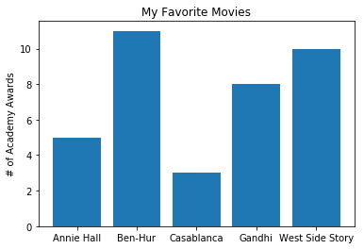
Bar charts
movies = ["Annie Hall", "Ben-Hur", "Casablanca", "Gandhi", "West Side Story"]
num_oscars = [5, 11, 3, 8, 10]
xs = range(len(movies)) # xs is range(5)
# plot bars with left x-coordinates [xs], # heights [num_oscars]
plt.bar(xs, num_oscars)
# label x-axis with movie names at bar centers
plt.xticks(xs, movies)
# alternatively, use the following to replace # the two lines above
#plt.bar(xs, num_oscars, tick_label=movies)
plt.ylabel("# of Academy Awards")
plt.title("My Favorite Movies")
plt.show()

Slide 27
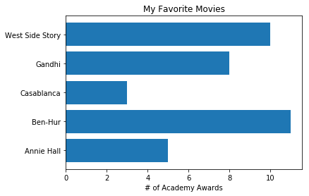
Barh vs bar
plt.barh(xs, num_oscars, tick_label=movies)
plt.xlabel("# of Academy Awards")
plt.title("My Favorite Movies")
Notes:
By default, the y-axis in a bar chart (or x-axis in barh) starts from 0, in contrast to a line chart.

Slide 28
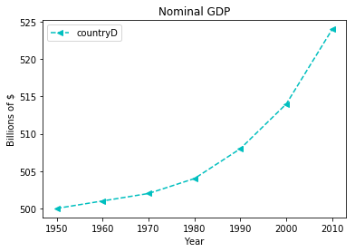
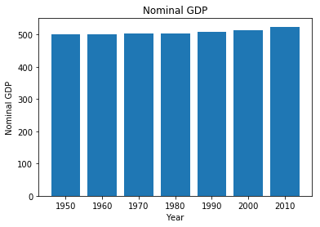
Line vs Bar
Notes:
By default, the y-axis in a bar chart (or x-axis in barh) starts from 0, in contrast to a line chart.

Slide 29
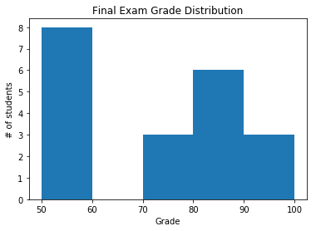
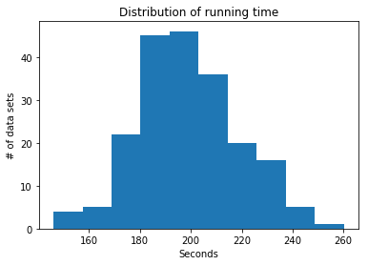
More examples of bar chart
These are also called histograms (discuss later)
More advanced bar charts (bar charts with multiple groups, etc.) will be discussed later in pandas.

Slide 30
Questions:
How wide should each interval be? How many classes should be used?
How should the endpoints of the intervals be determined?
Often answered by trial and error, subject to user judgment.
The goal is to create a distribution that is neither too "jagged" nor too "blocky”.
Remember, the goal is to appropriately show the pattern of variation in the data.
Many
Few
Notes:
Too many, can give a poor indication of how frequency varies across classes (sonic)
Too few, may compress variation too much and yield a blocky distribution. can obscure important patterns of variation.

Slide 31
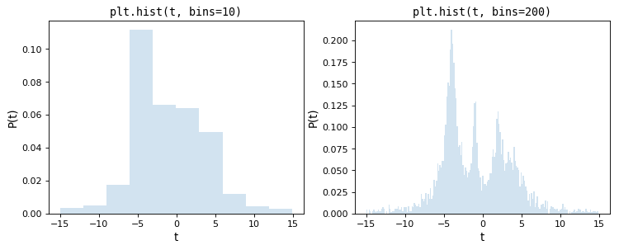
http://docs.astropy.org/en/stable/visualization/histogram.html
Choosing Histogram Bins: astropy
Notes:
Too few bins on left obscures the multi-modalness of the data seen on the right

Slide 32
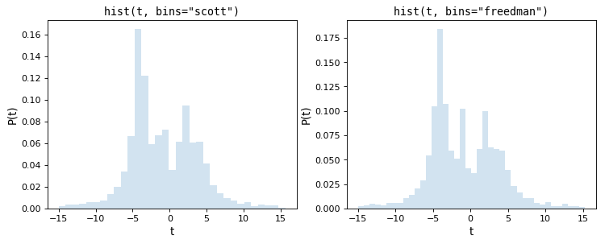
http://docs.astropy.org/en/stable/visualization/histogram.html
Choosing Histogram Bins: astropy
Notes:
The simplest methods of tuning the number of bins are the normal reference rules due to Scott (implemented in scott_bin_width()) and Freedman & Diaconis (implemented in freedman_bin_width()). These rules proceed by assuming the data is close to normally-distributed, and applying a rule-of-thumb intended to minimize the difference between the histogram and the underlying distribution of data.

Slide 33
Distribution Shape
The shape of the distribution is said to be symmetric if the observations are balanced, or evenly distributed, about the center.

Slide 34
Distribution Shape
(continued)
The shape of the distribution is said to be skewed if the observations are not symmetrically distributed around the center.
A positively skewed distribution (skewed to the right) has a tail that extends to the right in the direction of positive values.
A negatively skewed distribution (skewed to the left) has a tail that extends to the left in the direction of negative values.

Slide 35
Relationships Between Variables
Graphs illustrated so far have involved only a single variable.
When two variables exist other techniques are used:
Categorical
(Qualitative)
Variables
Numerical
(Quantitative)
Variables
Cross tables
Scatter plots

Slide 36
Scatter Diagrams
Scatter Diagrams are used for paired observations taken from two numerical variables.
One variable is measured on the vertical axis and the other variable is measured on the horizontal axis

Slide 37
Scatter Diagram Example
Volume per day | Cost per day
23 | 125
26 | 140
29 | 146
33 | 160
38 | 167
42 | 170
50 | 188
55 | 195
60 | 200

Slide 38
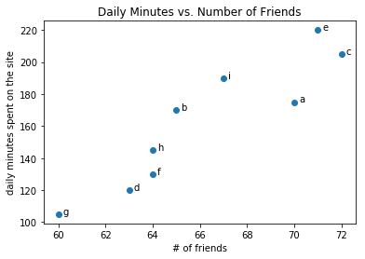
Scatterplots
friends = [ 70, 65, 72, 63, 71, 64, 60, 64, 67]
minutes = [175, 170, 205, 120, 220, 130, 105, 145, 190]
labels = ['a', 'b', 'c', 'd', 'e', 'f', 'g', 'h', 'i']
plt.scatter(friends, minutes)
# label each point
for i in range(len(friends)):
plt.annotate(labels[i], xy=(friends[i], minutes[i]),
xytext=(5, 0), textcoords='offset points')
plt.title("Daily Minutes vs. Number of Friends")
plt.xlabel("# of friends")
plt.ylabel("daily minutes spent on the site")

Slide 39
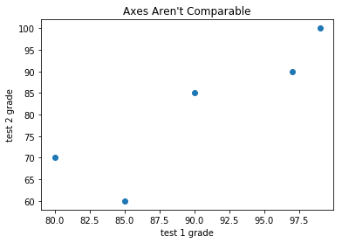
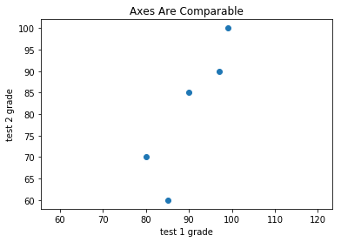
Similar to line plot, the axes of scatter plot can auto scale.
Can be set with xlim([xlow, xhigh]) or ylim([ylow, yhigh]) or axis([xlow, xhigh, ylow, yhigh])
Or force equal range with axis(‘equal’)
plt.scatter(test_1_grades, test_2_grades)
plt.scatter(test_1_grades, test_2_grades)
plt.axis("equal")

Slide 40
Review
Reviewed types of data and measurement levels.
Data organization by table and graph.
Techniques reviewed:
Frequency distribution
Bar chart, Pie chart, Line chart
Pareto diagram
Frequency distribution, Histogram and ogive
Scatter plot

Slide 41
Other important functions
Create figures with numbers
E.g. plt.figure(1), plt.figure(2), etc, to specify which figure to plot on
Useful when dealing with multiple figures at the same time
plt.xticks()
plt.yticks()
plt.savefig()
Type in plt.savefig? for usage or search matplotlib documentation for more details

Slide 42
Describing Data
Numerically

Slide 43
Describing Data Numerically
Describing Data Numerically
Central Tendency
Variation
Arithmetic Mean
Range
Median
Interquartile Range
Mode
Variance
Standard Deviation
Coefficient of Variation
Notes:
Measures of central tendency, variation, and shape
Mean, median, mode, geometric mean
Quartiles
Range, interquartile range, variance and standard deviation, coefficient of variation
Symmetric and skewed distributions
Population summary measures
Mean, variance, and standard deviation
The empirical rule and Bienaymé-Chebyshev rule

Slide 44
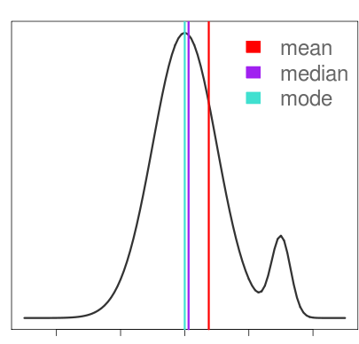
Measures of Central Tendency
Mean: Arithmetic average
Median: Midpoint of ranked values
Mode: Most frequently observed value
Notes:
The arithmetic mean (mean) is the most common measure of central tendency. Affected by extreme values (outliers)
Now that you’ve learned about various measure of central tendency, you might be asking yourself: how do they compare?
For symmetric distributions, the mean, median are equal, as is the mode except in bimodal distributions.

Slide 45
Mean
Population Mean
Population values
Population size
Sample Mean
Observed values
Sample size
Notes:
The arithmetic mean (mean) is the most common measure of central tendency. Affected by extreme values (outliers)
Balancing point of the histogram

Slide 46
Population vs Sample
Population: all members of a group in a study
Ex. The average height of men
The average height of living male ≥ 18yr in USA between 2001 and 2010
The average height of all male students ≥ 18yr
Sample: a subset of the members in the population
Most studies choose to sample the population due to cost/time or other factors
Each sample is only one of many possible subsets of the population
May or may not be representative of the whole population
Sample size and sampling procedure is important

Slide 47
Median
The “Middle” of the data (sorted)
If the number of values is odd, the median is the middle number
If the number of values is even, the median is the average of the two middle numbers
Not affected by extreme values
Notes:
The arithmetic mean (mean) is the most common measure of central tendency. Affected by extreme values (outliers)
Balancing point of the histogram

Slide 48
Median
Notes:
Average income rose dramatically but median income hasn’t
https://www.cbsnews.com/news/mean-vs-median-income-growth/

Slide 49
Mode
The most frequent value in the data.
Not effected by extreme values.
Used for both numerical and categorical data.
There may be one, several, or no modes.
0 1 2 3 4 5 6 7 8 9 10 11 12 13 14
0 1 2 3 4 5 6
Notes:
The arithmetic mean (mean) is the most common measure of central tendency. Affected by extreme values (outliers)
Balancing point of the histogram

Slide 50
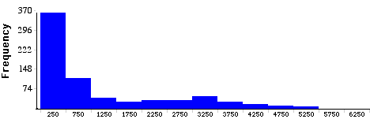
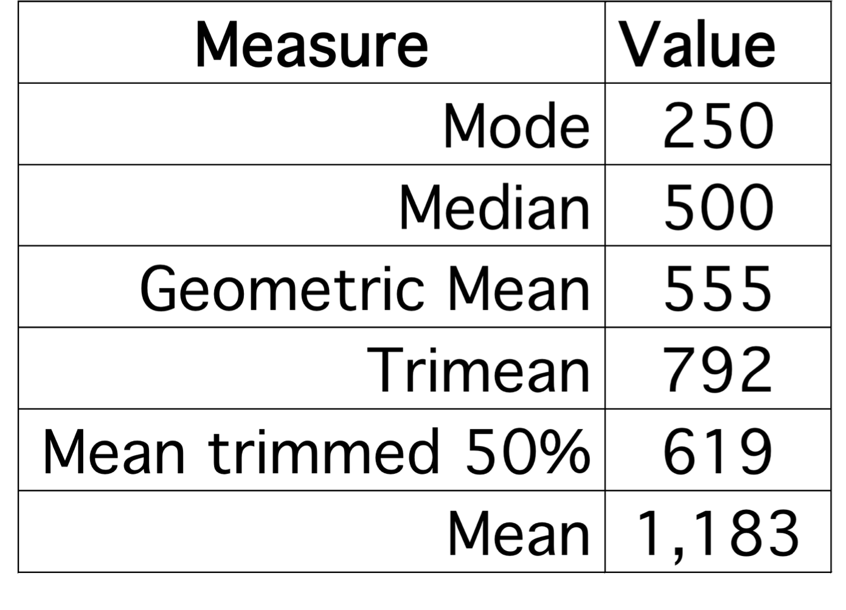
Severe Skew
Notes:
The graph shows the distribution of baseball players’ salaries in the year 1994. This time, the measures of central tendency all are very different and no single one of them conveys the complete story.
For example, the mean of over 1.1 million dollars is misleading because only 1/3 of baseball players make that much. However, neither the mode of a quarter million nor the median of half a million dollars would suggest that some players make many millions of dollars.
As is typically the case with skewed distributions, the geometric mean, the trimean, and the trimmed mean are between the median and the mean.

Slide 51
What to report?
Mean, or median?
Media typically report the median of a skewed distribution
Notes:
So what should you report when the various measures differ? We believe that you should report the mean, the median, and sometimes either the trimean or a the mean trimmed 50%. Occasionally it is worth reporting the mode as well.
In the media, the median is usually reported to summarize the center of skewed distributions. You will hear about median salaries and median prices of houses sold, etc. This is not a bad practice, and is better than reporting only the mean. However, it would be better to hear more statistics.

Slide 52
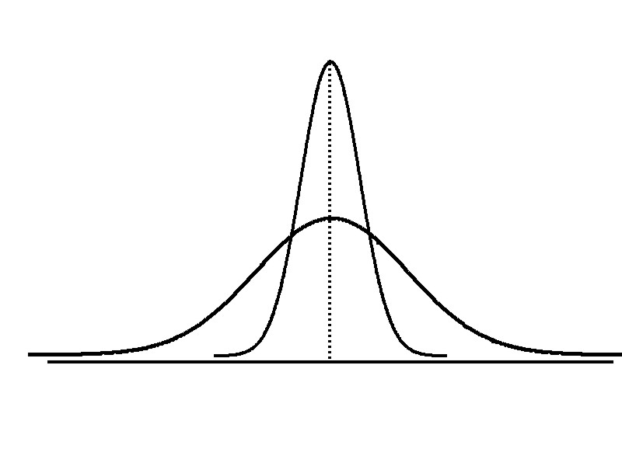
Measures of Variability
Variation
Range
Interquartile
Range
Variance
Standard Deviation
Coefficient of Variation
Measures of variation give information on the spread or variability of the data values.
Same center,
different variation

Slide 53
Range
Simplest measure of variation
Difference between the largest and the smallest observations:
Range = X_{largest} – X_{smallest}
Example:
0 1 2 3 4 5 6 7 8 9 10 11 12 13 14
Range = 14 - 1 = 13

Slide 54
Disadvantages of the Range
Ignores the way in which data are distributed, sensitive to outliers
Range: 5 – 1 = 4
Range: 120 – 1 = 119
7 8 9 10 11 12
7 8 9 10 11 12
Range = 12 - 7 = 5
Range = 12 - 7 = 5
1,1,1,1,1,1,1,1,1,1,1,2,2,2,2,2,2,2,2,3,3,3,3,4,5
1,1,1,1,1,1,1,1,1,1,1,2,2,2,2,2,2,2,2,3,3,3,3,4,120

Slide 55
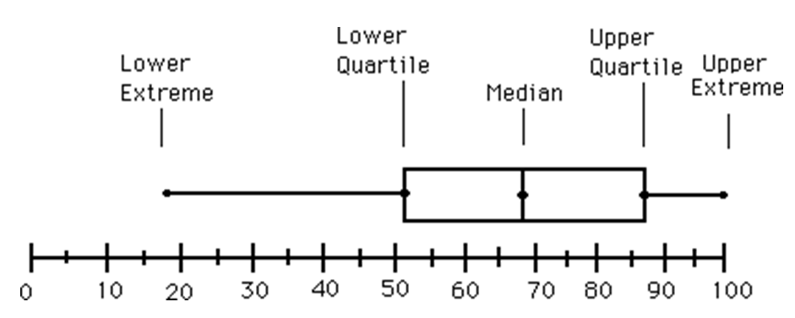
Interquartile Range
Eliminate high- and low-valued observations and calculate the range of the middle 50% of the data
Interquartile range = 3rd quartile – 1st quartile
IQR = 87 – 51 = 36
Notes:
Can eliminate some outlier problems by using the interquartile range
Eliminate high- and low-valued observations and calculate the range of the middle 50% of the data
The first quartile, Q₁, is the value for which 25% of the observations are smaller and 75% are larger
Q₂ is the same as the median (50% are smaller, 50% are larger)
Only 25% of the observations are greater than the third quartile
Interquartile range = 3rd quartile – 1st quartile
IQR = Q₃ – Q₁

Slide 56
Boxplots

Slide 57
Measuring Variation
Small standard deviation
Larger standard deviation

Slide 58
Measuring Variation
Standard Deviation (sqrt of Variance) most commonly used measure of variation.
Shows variation about the mean. Values far from the mean are given extra weight (squared!)
A function of all the data.
Has the same units as the original data.
= population mean
N = population size
x_{i} = i^{th} value of the variable x

Slide 59
The 68-95-99.7 Rule
68%
95%
99.7%

Slide 60
The Sample Covariance
The covariance measures the strength of the linear relationship between two variables
Only concerned with the strength of the relationship
No causal effect is implied
The population covariance:
The sample covariance:

Slide 61
Interpreting Covariance
Covariance between two variables:
Cov(x,y) > 0 x and y tend to move in the same direction
Cov(x,y) < 0 x and y tend to move in opposite directions
Cov(x,y) = 0 x and y are independent

Slide 62
Coefficient of Correlation
Measures the relative strength of the linear relationship between two variables
Population correlation coefficient:
Sample correlation coefficient:

Slide 63
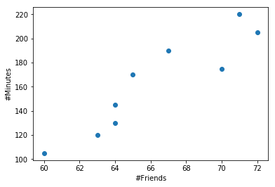
friends = array([ 70, 65, 72, 63, 71, 64, 60, 64, 67])
minutes = array([175, 170, 205, 120, 220, 130, 105, 145, 190])
np.corrcoef(friends, minutes)
Notes:
array([[ 1. , 0.92246383], [ 0.92246383, 1. ]])

Slide 64
Features of Correlation Coefficient, r
Unit free
Ranges between –1 and 1
The closer to –1, the stronger the negative linear relationship
The closer to 1, the stronger the positive linear relationship
The closer to 0, the weaker any positive linear relationship
R^2 the ”coefficient of determination” or what percentage of the variance is explained by the linear relationship.

Slide 65
Example: Varying Correlation Coefficients

Slide 66
Interpreting the Result
r = 0.733
There is a relatively strong positive linear relationship between test score #1 and test score #2.
Students who scored high on the first test tended to score high on second test.

Slide 67
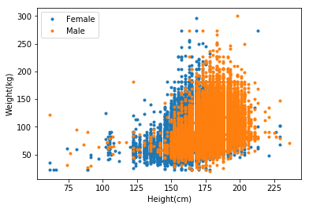
Corr. Between height/weight
corrcoef(weight, height)[0][1]
0.5110289460952534

Slide 68
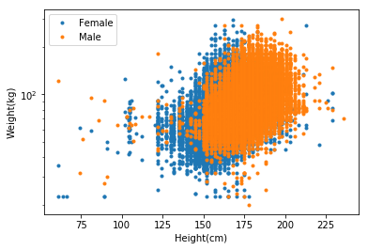
Corr. Between height/weight
corrcoef(log(weight), height)[0][1]
0.53405888354314057

Slide 69
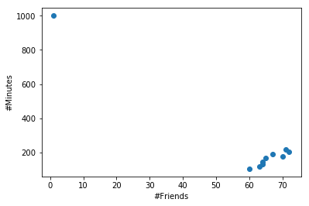
Pearson Correlation Sensitive to Outliers
friends2=np.append(friends,1)
minutes2=np.append(minutes,1000)
np.corrcoef(friends2, minutes2)[0,1]
-0.95014946790238775

Slide 70
Correlation
Measures the linear relationship between two variables, X = [x₁, x₂, …X_{n}], and Y = [y₁, y₂, …, y_{n}]
E.g. between one’s height and weight
Between results of two tests
Problem: two variables may be different units, on different scales, or from different distributions.
Option 1: convert the measurement to standardized score (z-score)
Pearson Correlation Coefficient
Option 2: sort the values and convert the measurement to ranks
Spearman Rank Correlation Coefficient

